Slide 1
Lab 2
Expressions Tree and Parsing Strategies

Slide 2
Part I Expressions Tree

Slide 3
Recursive Structure of Expressions
In most programming languages, an expression is a recursive structure that can contain subexpressions.
In the model in Chapter 17, every expression falls into one of the following forms:
  An integer constant
  A variable name that holds an integer value
  Two expressions joined by an operator
  An expression enclosed in parentheses
This structure can be represented in the form of a grammar.
E → constant
E → identifier
E → E op E
E → ( E )

Slide 4
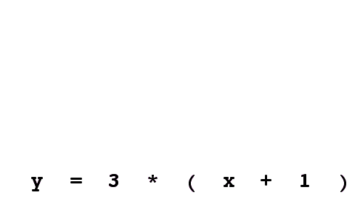
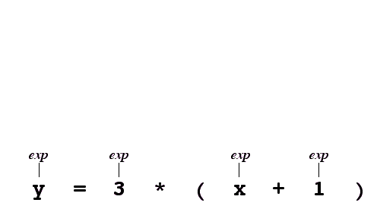
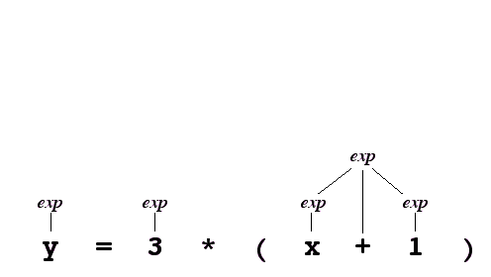
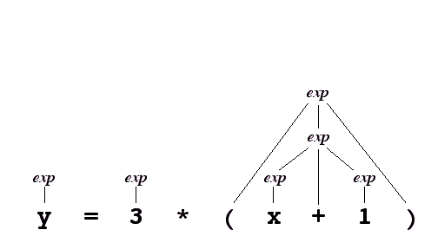
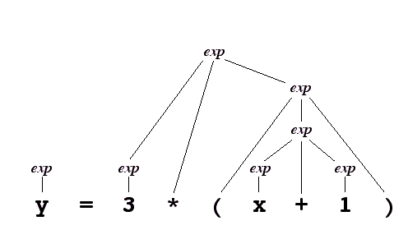
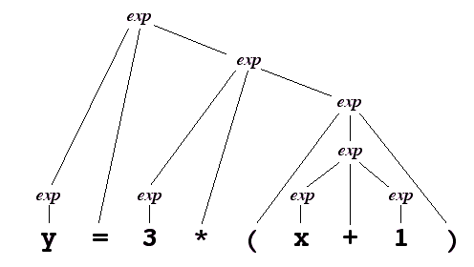
Parse Trees
When the C++ compiler looks at an expression, it needs to understand what the expression means by translating it into an internal form. This process generally consists of two steps:
  Lexical analysis, in which the source text is broken up into units called tokens.
  Parsing, in which the tokens are assembled into a recursive structure called an parse tree that embodies its structure.

Slide 5
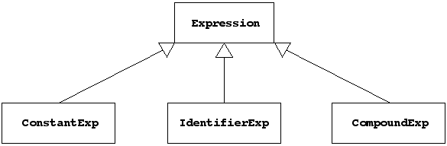
The Expression Class Hierarchy
Because expressions have more than one form, a C++ class that represents expressions can be represented most easily by a class hierarchy in which each of the expression types is a separate subclass, as shown in the following diagram:

Slide 6
Representing Inheritance in C++
The first step in creating a C++ subclass is to indicate the superclass on the header line, using the following syntax:
class subclass: public superclass {
body of class definition
}
In contrast to Java, a subclass does not automatically override the definition of a method in its superclass. To permit such overriding, both classes must mark the prototype for that method with the keyword virtual.
An abstract class is a class that doesn’t actually represent any objects but instead serves only as a common superclass for concrete classes that do correspond to objects. In C++, methods for an abstract class that are always implemented by the concrete subclasses are indicated by including = 0 before the semicolon on the prototype line.

Slide 7
The exp.h Interface
/*
* File: exp.h
* -----------
* This interface defines a class hierarchy for expressions,
* which allows the client to represent and manipulate simple
* binary expression trees.
*/
#ifndef _exp_h
#define _exp_h
#include <string>
#include "evalstate.h"
/*
* Type: ExpressionType
* --------------------
* This enumerated type is used to differentiate the three different
* expression types: CONSTANT, IDENTIFIER, and COMPOUND.
*/
enum ExpressionType { CONSTANT, IDENTIFIER, COMPOUND };

Slide 8
The exp.h Interface
/*
* Class: Expression
* -----------------
* This class is used to represent a node in an expression tree.
* Expression is an example of an abstract class, which defines the
* structure and behavior of a set of classes but has no objects of its
* own. Any object must be one of its three concrete subclasses:
*
* 1. ConstantExp -- an integer constant
* 2. IdentifierExp -- a string representing an identifier
* 3. CompoundExp -- two expressions combined by an operator
*
* The abstract class defines an interface common to all Expression objects;
* each subclass provides its own implementation of the common interface.
*/
class Expression {
public:
Expression();
virtual ~Expression();
virtual int eval(EvalState & state) = 0;
virtual std::string toString() = 0;
virtual ExpressionType type() = 0;
};
/*
* File: exp.h
* -----------
* This interface defines a class hierarchy for expressions,
* which allows the client to represent and manipulate simple
* binary expression trees.
*/
#ifndef _exp_h
#define _exp_h
#include <string>
#include "evalstate.h"
/*
* Type: ExpressionType
* --------------------
* This enumerated type is used to differentiate the three different
* expression types: CONSTANT, IDENTIFIER, and COMPOUND.
*/
enum ExpressionType { CONSTANT, IDENTIFIER, COMPOUND };
Methods that can only be virtual are marked with an = 0 like this.
In C++, any method that can be overridden by its subclasses must be marked as virtual.

Slide 9
The exp.h Interface
/*
* Class: ConstantExp
* ------------------
* This subclass represents a constant integer expression.
*/
class ConstantExp: public Expression {
public:
ConstantExp(int val);
virtual int eval(EvalState & state);
virtual std::string toString();
virtual ExpressionType type();
int getValue();
private:
int value;
};
/*
* Class: Expression
* -----------------
* This class is used to represent a node in an expression tree.
* Expression is an example of an abstract class, which defines the
* structure and behavior of a set of classes but has no objects of its
* own. Any object must be one of its three concrete subclasses:
*
* 1. ConstantExp -- an integer constant
* 2. IdentifierExp -- a string representing an identifier
* 3. CompoundExp -- two expressions combined by an operator
*
* The abstract class defines an interface common to all Expression objects;
* each subclass provides its own implementation of the common interface.
*/
class Expression {
public:
Expression();
virtual ~Expression();
virtual int eval(EvalState & state) = 0;
virtual std::string toString() = 0;
virtual ExpressionType type() = 0;
};

Slide 10
The exp.h Interface
/*
* Class: IdentifierExp
* --------------------
* This subclass represents a expression corresponding to a variable.
*/
class IdentifierExp: public Expression {
public:
IdentifierExp(string name);
virtual int eval(EvalState & state);
virtual std::string toString();
virtual ExpressionType type();
string getName();
private:
std::string name;
};
/*
* Class: ConstantExp
* ------------------
* This subclass represents a constant integer expression.
*/
class ConstantExp: public Expression {
public:
ConstantExp(int val);
virtual int eval(EvalState & state);
virtual std::string toString();
virtual ExpressionType type();
int getValue();
private:
int value;
};

Slide 11
The exp.h Interface
/*
* Class: CompoundExp
* ------------------
* This subclass represents a compound expression.
*/
class CompoundExp: public Expression {
public:
CompoundExp(char op, Expression *lhs, Expression *rhs);
virtual ~CompoundExp();
virtual int eval(EvalState & state);
virtual std::string toString();
virtual ExpressionType type();
std::string getOp();
Expression *getLHS();
Expression *getRHS();
private:
std::string op;
Expression *lhs, *rhs;
};
#endif
/*
* Class: IdentifierExp
* --------------------
* This subclass represents a expression corresponding to a variable.
*/
class IdentifierExp: public Expression {
public:
IdentifierExp(string name);
virtual int eval(EvalState & state);
virtual std::string toString();
virtual ExpressionType type();
string getName();
private:
std::string name;
};

Slide 12
The evalstate.h Interface
/*
* File: evalstate.h
* -----------------
* This interface exports the EvalState class, which keeps track of
* information required by the evaluator, such as the values of variables.
*/
#ifndef _evalstate_h
#define _evalstate_h
#include <string>
#include "map.h"
class EvalState {
public:
EvalState();
~EvalState();
void setValue(std::string var, int value);
int getValue(std::string var);
bool isDefined(std::string var);
private:
Map<int> symbolTable;
};
#endif

Slide 13
Code for the eval Method
int ConstantExp::eval(EvalState & state) {
return value;
}
int IdentifierExp::eval(EvalState & state) {
if (!state.isDefined(name)) error(name + " is undefined");
return state.getValue(name);
}
int CompoundExp::eval(EvalState & state) {
if (op == "=") {
if (lhs->getType() != IDENTIFIER) error("Illegal lhs in assignment");
int val = rhs->eval(state);
state.setValue(((IdentifierExp *) lhs)->getName(), val);
return val;
}
int left = lhs->eval(state);
int right = rhs->eval(state);
if (op == "+") return left + right;
if (op == "-") return left - right;
if (op == "*") return left * right;
if (op == "/") return left / right;
if (op == "%") return left % right;
error("Illegal operator in expression");
return 0;
}

Slide 14
Part II: Parsing Strategies
Eric Roberts, CS 106B, Stanford

Slide 15
Updated Slide on Job Outlook
Phil Levis, http://csl.stanford.edu/~pal/ed/
Doctorate
161,857
Master’s
Bachelor’s
Job openings
129,045
94,889
49,200
57,127
55,208
31,357
10,075
Physical Sciences
Biological Sciences
Engineering
Computer Science
The educational data comes from the National Center for Education Statistics IPEDS (Integrated Postsecondary Education Data System) Data Center. The data used is for degrees granted in the 2008-2009 academic year.
The employment data comes from the Department of Labor’s Occupational Outlook Handbook for 2010-11. This handbook includes employment for 2008 as well as a 10-year projection to 2018. I manually selected which occupations mapped to which degrees. I calculated job openings per year as 10% of the expected job growth over 2008-2018 plus 2.5% of the number of jobs in 2008. This second term describes the number of jobs opening as people retire. It assumes that people work for 40 years and leave a job at a uniform rate; the latter is of course not true in difficult economic times.
We are very happy with the students that we get from this university. . . . We just wish we could hire two to three times as many of them.
—
Bill Gates at Stanford, February 19, 2008

Slide 16
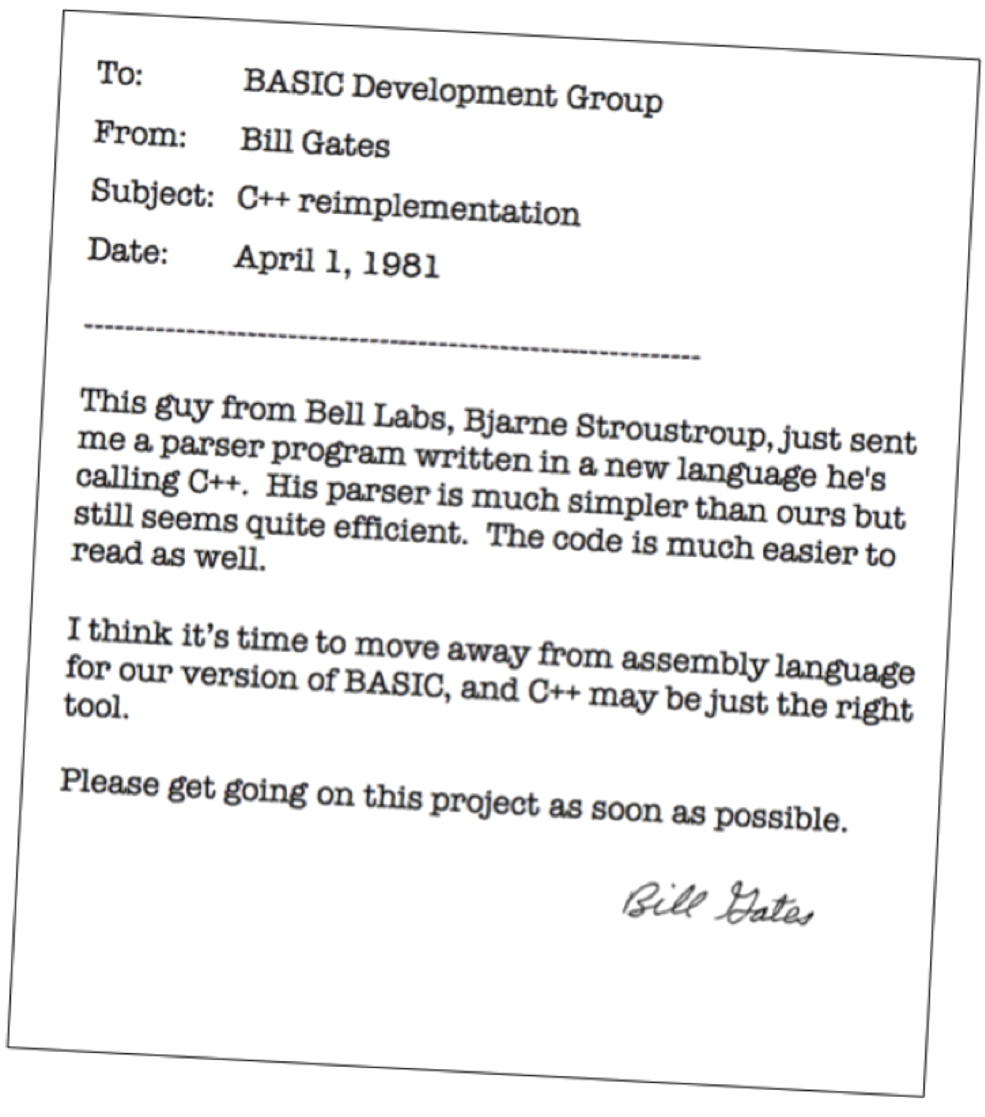

Slide 17
Outline for Today
1.
Review the expression hierarchy
2.
Walk through a simple evaluation
3.
Explore the relationship between parsing and grammars
4.
Look at the final version of parser.cpp
5.
Walk through an example of the parser in action
6.
Review the structure of the Basic assignment

Slide 18
The Expression Hierarchy
On last course, I defined an abstract Expression class with three concrete subclasses, one for each of the expression types:

Slide 19
Code for the eval Method
int ConstantExp::eval(EvalState & state) {
return value;
}
int IdentifierExp::eval(EvalState & state) {
if (!state.isDefined(name)) error(name + " is undefined");
return state.getValue(name);
}
int CompoundExp::eval(EvalState & state) {
if (op == "=") {
if (lhs->getType() != IDENTIFIER) error("Illegal lhs in assignment");
int val = rhs->eval(state);
state.setValue(((IdentifierExp *) lhs)->getName(), val);
return val;
}
int left = lhs->eval(state);
int right = rhs->eval(state);
if (op == "+") return left + right;
if (op == "-") return left - right;
if (op == "*") return left * right;
if (op == "/") return left / right;
if (op == "%") return left % right;
error("Illegal operator in expression");
return 0;
}

Slide 20
Exercise: Evaluating an Expression
Assuming x is bound to 3, trace through the steps in evaluating
y = ( 9 – x ) * 7
COMPOUND
=
COMPOUND
*
COMPOUND
–
IDENTIFIER
CONSTANT
IDENTIFIER
CONSTANT
y
9
x
7

Slide 21
The Problem of Parsing
On last course, I noted that the rules for forming an expression can be expressed in the form of a grammar, as follows:
E → constant
E → identifier
E → E op E
E → ( E )
The process of translating an expression from a string to its internal form is called parsing.

Slide 22
A Two-Level Grammar
The problem of parsing an expression can be simplified by changing the grammar to one that has two levels:
  An expression is either a term or two expressions joined by an operator.
  A term is either a constant, an identifier, or an expression enclosed in parentheses.
This design is reflected in the following revised grammar.
E → T
E → E op E
T → constant
T → identifier
T → ( E )

Slide 23
Ambiguity in Parse Structures
Although the two-level grammar from the preceding slide can recognize any expression, it is ambiguous because the same input string can generate more than one parse tree.
E
E
E
E
T
T
T
T
T
T
x
+
2
*
y
x
+
2
*
y
Ambiguity in grammars is typically resolved by providing the parser with information about the precedence of the operators. The text describes two strategies: Iversonian precedence, in which the operators all group to the right, and operator precedence, in which each operator is associated with an integer that defines its place in the precedence hierarchy.

Slide 24
Exercise: Parsing an Expression
Diagram the expression tree that results from the input string
odd
=
2
*
n
+
1
COMPOUND
=
COMPOUND
+
COMPOUND
*
IDENTIFIER
CONSTANT
IDENTIFIER
CONSTANT
odd
2
n
1

Slide 25
The parser.cpp Implementation
/*
* Implementation notes: readE
* Usage: exp = readE(scanner, prec);
* ----------------------------------
* This function reads the next expression from the scanner by
* matching the input to the following ambiguous grammar:
*
* E -> T
* E -> E op E
*
* This version of the method uses precedence to resolve ambiguity.
*/
Expression *readE(TokenScanner & scanner, int prec) {
Expression *exp = readT(scanner);
string token;
while (true) {
token = scanner.nextToken();
int newPrec = precedence(token);
if (newPrec <= prec) break;
Expression *rhs = readE(scanner, newPrec);
exp = new CompoundExp(token, exp, rhs);
}
scanner.saveToken(token);
return exp;
}

Slide 26
The parser.cpp Implementation
/*
* Function: readT
* Usage: exp = readT(scanner);
* ----------------------------
* This function reads a single term from the scanner.
*/
Expression *readT(TokenScanner & scanner) {
string token = scanner.nextToken();
TokenType type = scanner.getTokenType(token);
if (type == WORD) return new IdentifierExp(token);
if (type == NUMBER) return new ConstantExp(stringToInteger(token));
if (token != "(") error("Illegal term in expression");
Expression *exp = readE(scanner);
if (scanner.nextToken() != ")") {
error("Unbalanced parentheses in expression");
}
return exp;
}
/*
* Implementation notes: readE
* Usage: exp = readE(scanner, prec);
* ----------------------------------
* This function reads the next expression from the scanner by
* matching the input to the following ambiguous grammar:
*
* E -> T
* E -> E op E
*
* This version of the method uses precedence to resolve ambiguity.
*/
Expression *readE(TokenScanner & scanner, int prec) {
Expression *exp = readT(scanner);
string token;
while (true) {
token = scanner.nextToken();
int newPrec = precedence(token);
if (newPrec <= prec) break;
Expression *rhs = readE(scanner, newPrec);
exp = new CompoundExp(token, exp, rhs);
}
scanner.saveToken(token);
return exp;
}

Slide 27
The parser.cpp Implementation
/*
* Function: precedence
* Usage: prec = precedence(token);
* --------------------------------
* This function returns the precedence of the specified operator
* token. If the token is not an operator, precedence returns 0.
*/
int precedence(string token) {
if (token == "=") return 1;
if (token == "+" || token == "-") return 2;
if (token == "*" || token == "/") return 3;
return 0;
}
/*
* Function: readT
* Usage: exp = readT(scanner);
* ----------------------------
* This function reads a single term from the scanner.
*/
Expression *readT(TokenScanner & scanner) {
string token = scanner.nextToken();
TokenType type = scanner.getTokenType(token);
if (type == WORD) return new IdentifierExp(token);
if (type == NUMBER) return new ConstantExp(stringToInteger(token));
if (token != "(") error("Illegal term in expression");
Expression *exp = readE(scanner);
if (scanner.nextToken() != ")") {
error("Unbalanced parentheses in expression");
}
return exp;
}

Slide 28
Tracing the Precedence Parser
int main() {
TokenScanner scanner = new TokenScanner();
scanner.setInput("odd = 2 * n + 1");
scanner.ignoreWhitespace();
Expression *exp = readE(scanner);
. . .
}
scanner
exp
odd = 2 * n + 1
^
skip simulation

Slide 29
Tracing the Precedence Parser
int main() {
TokenScanner scanner = new TokenScanner();
scanner.setInput("odd = 2 * n + 1");
scanner.ignoreWhitespace();
Expression *exp = readE(scanner);
. . .
}
Expression *readE(TokenScanner & scanner, int prec) {
Expression *exp = readT(scanner);
string token;
while (true) {
token = scanner.nextToken();
int newPrec = precedence(token);
if (newPrec <= prec) break;
Expression *rhs = readE(scanner, newPrec);
exp = new CompoundExp(token, exp, rhs);
}
scanner.saveToken(token);
return exp;
}
scanner
prec
newPrec
token
exp
rhs
odd = 2 * n + 1
0
^

Slide 30
Tracing the Precedence Parser
int main() {
TokenScanner scanner = new TokenScanner();
scanner.setInput("odd = 2 * n + 1");
scanner.ignoreWhitespace();
Expression *exp = readE(scanner);
. . .
}
Expression *readE(TokenScanner & scanner, int prec) {
Expression *exp = readT(scanner);
string token;
while (true) {
token = scanner.nextToken();
int newPrec = precedence(token);
if (newPrec <= prec) break;
Expression *rhs = readE(scanner, newPrec);
exp = new CompoundExp(token, exp, rhs);
}
scanner.saveToken(token);
return exp;
}
Expression *readT(TokenScanner & scanner) {
string token = scanner.nextToken();
TokenType type = scanner.getTokenType(token);
if (type == WORD) return new IdentifierExp(token);
if (type == NUMBER) return new ConstantExp(stringToInteger(token));
if (token != "(") error("Illegal term in expression");
Expression *exp = readE(scanner);
if (scanner.nextToken() != ")") {
error("Unbalanced parentheses in expression");
}
return exp;
}
scanner
prec
newPrec
token
exp
rhs
0
odd = 2 * n + 1
scanner
type
token
exp
^
odd = 2 * n + 1
WORD
odd
^
^

Slide 31
Tracing the Precedence Parser
int main() {
TokenScanner scanner = new TokenScanner();
scanner.setInput("odd = 2 * n + 1");
scanner.ignoreWhitespace();
Expression *exp = readE(scanner);
. . .
}
Expression *readE(TokenScanner & scanner, int prec) {
Expression *exp = readT(scanner);
string token;
while (true) {
token = scanner.nextToken();
int newPrec = precedence(token);
if (newPrec <= prec) break;
Expression *rhs = readE(scanner, newPrec);
exp = new CompoundExp(token, exp, rhs);
}
scanner.saveToken(token);
return exp;
}
Expression *readT(TokenScanner & scanner) {
string token = scanner.nextToken();
TokenType type = scanner.getTokenType(token);
if (type == WORD) return new IdentifierExp(token);
if (type == NUMBER) return new ConstantExp(stringToInteger(token));
if (token != "(") error("Illegal term in expression");
Expression *exp = readE(scanner);
if (scanner.nextToken() != ")") {
error("Unbalanced parentheses in expression");
}
return exp;
}
scanner
prec
newPrec
token
exp
rhs
scanner
type
token
exp
odd = 2 * n + 1
0

Slide 32
Tracing the Precedence Parser
int main() {
TokenScanner scanner = new TokenScanner();
scanner.setInput("odd = 2 * n + 1");
scanner.ignoreWhitespace();
Expression *exp = readE(scanner);
. . .
}
Expression *readE(TokenScanner & scanner, int prec) {
Expression *exp = readT(scanner);
string token;
while (true) {
token = scanner.nextToken();
int newPrec = precedence(token);
if (newPrec <= prec) break;
Expression *rhs = readE(scanner, newPrec);
exp = new CompoundExp(token, exp, rhs);
}
scanner.saveToken(token);
return exp;
}
scanner
prec
newPrec
token
exp
rhs
odd = 2 * n + 1
0
1
=
^
^
ID
odd

Slide 33
Tracing the Precedence Parser
int main() {
TokenScanner scanner = new TokenScanner();
scanner.setInput("odd = 2 * n + 1");
scanner.ignoreWhitespace();
Expression *exp = readE(scanner);
. . .
}
Expression *readE(TokenScanner & scanner, int prec) {
Expression *exp = readT(scanner);
string token;
while (true) {
token = scanner.nextToken();
int newPrec = precedence(token);
if (newPrec <= prec) break;
Expression *rhs = readE(scanner, newPrec);
exp = new CompoundExp(token, exp, rhs);
}
scanner.saveToken(token);
return exp;
}
Expression *readE(TokenScanner & scanner, int prec) {
Expression *exp = readT(scanner);
string token;
while (true) {
token = scanner.nextToken();
int newPrec = precedence(token);
if (newPrec <= prec) break;
Expression *rhs = readE(scanner, newPrec);
exp = new CompoundExp(token, exp, rhs);
}
scanner.saveToken(token);
return exp;
}
scanner
prec
newPrec
token
exp
rhs
scanner
prec
newPrec
token
exp
rhs
odd = 2 * n + 1
0
1
=
^
odd = 2 * n + 1
1
^
ID
odd

Slide 34
Tracing the Precedence Parser
int main() {
TokenScanner scanner = new TokenScanner();
scanner.setInput("odd = 2 * n + 1");
scanner.ignoreWhitespace();
Expression *exp = readE(scanner);
. . .
}
Expression *readE(TokenScanner & scanner, int prec) {
Expression *exp = readT(scanner);
string token;
while (true) {
token = scanner.nextToken();
int newPrec = precedence(token);
if (newPrec <= prec) break;
Expression *rhs = readE(scanner, newPrec);
exp = new CompoundExp(token, exp, rhs);
}
scanner.saveToken(token);
return exp;
}
Expression *readE(TokenScanner & scanner, int prec) {
Expression *exp = readT(scanner);
string token;
while (true) {
token = scanner.nextToken();
int newPrec = precedence(token);
if (newPrec <= prec) break;
Expression *rhs = readE(scanner, newPrec);
exp = new CompoundExp(token, exp, rhs);
}
scanner.saveToken(token);
return exp;
}
Expression *readT(TokenScanner & scanner) {
string token = scanner.nextToken();
TokenType type = scanner.getTokenType(token);
if (type == WORD) return new IdentifierExp(token);
if (type == NUMBER) return new ConstantExp(stringToInteger(token));
if (token != "(") error("Illegal term in expression");
Expression *exp = readE(scanner);
if (scanner.nextToken() != ")") {
error("Unbalanced parentheses in expression");
}
return exp;
}
scanner
prec
newPrec
token
exp
rhs
scanner
prec
newPrec
token
exp
rhs
odd = 2 * n + 1
0
1
=
^
^
scanner
type
token
exp
odd = 2 * n + 1
1
^
odd = 2 * n + 1
NUMBER
2
^
^
ID
odd

Slide 35
Tracing the Precedence Parser
int main() {
TokenScanner scanner = new TokenScanner();
scanner.setInput("odd = 2 * n + 1");
scanner.ignoreWhitespace();
Expression *exp = readE(scanner);
. . .
}
Expression *readE(TokenScanner & scanner, int prec) {
Expression *exp = readT(scanner);
string token;
while (true) {
token = scanner.nextToken();
int newPrec = precedence(token);
if (newPrec <= prec) break;
Expression *rhs = readE(scanner, newPrec);
exp = new CompoundExp(token, exp, rhs);
}
scanner.saveToken(token);
return exp;
}
Expression *readE(TokenScanner & scanner, int prec) {
Expression *exp = readT(scanner);
string token;
while (true) {
token = scanner.nextToken();
int newPrec = precedence(token);
if (newPrec <= prec) break;
Expression *rhs = readE(scanner, newPrec);
exp = new CompoundExp(token, exp, rhs);
}
scanner.saveToken(token);
return exp;
}
Expression *readT(TokenScanner & scanner) {
string token = scanner.nextToken();
TokenType type = scanner.getTokenType(token);
if (type == WORD) return new IdentifierExp(token);
if (type == NUMBER) return new ConstantExp(stringToInteger(token));
if (token != "(") error("Illegal term in expression");
Expression *exp = readE(scanner);
if (scanner.nextToken() != ")") {
error("Unbalanced parentheses in expression");
}
return exp;
}
scanner
prec
newPrec
token
exp
rhs
scanner
prec
newPrec
token
exp
rhs
odd = 2 * n + 1
0
1
=
^
^
1
odd = 2 * n + 1
scanner
type
token
exp
^
ID
odd

Slide 36
Tracing the Precedence Parser
int main() {
TokenScanner scanner = new TokenScanner();
scanner.setInput("odd = 2 * n + 1");
scanner.ignoreWhitespace();
Expression *exp = readE(scanner);
. . .
}
Expression *readE(TokenScanner & scanner, int prec) {
Expression *exp = readT(scanner);
string token;
while (true) {
token = scanner.nextToken();
int newPrec = precedence(token);
if (newPrec <= prec) break;
Expression *rhs = readE(scanner, newPrec);
exp = new CompoundExp(token, exp, rhs);
}
scanner.saveToken(token);
return exp;
}
Expression *readE(TokenScanner & scanner, int prec) {
Expression *exp = readT(scanner);
string token;
while (true) {
token = scanner.nextToken();
int newPrec = precedence(token);
if (newPrec <= prec) break;
Expression *rhs = readE(scanner, newPrec);
exp = new CompoundExp(token, exp, rhs);
}
scanner.saveToken(token);
return exp;
}
scanner
prec
newPrec
token
exp
rhs
scanner
prec
newPrec
token
exp
rhs
odd = 2 * n + 1
0
1
=
^
odd = 2 * n + 1
1
3
*
^
^
ID
CONST
odd
2

Slide 37
Tracing the Precedence Parser
int main() {
TokenScanner scanner = new TokenScanner();
scanner.setInput("odd = 2 * n + 1");
scanner.ignoreWhitespace();
Expression *exp = readE(scanner);
. . .
}
Expression *readE(TokenScanner & scanner, int prec) {
Expression *exp = readT(scanner);
string token;
while (true) {
token = scanner.nextToken();
int newPrec = precedence(token);
if (newPrec <= prec) break;
Expression *rhs = readE(scanner, newPrec);
exp = new CompoundExp(token, exp, rhs);
}
scanner.saveToken(token);
return exp;
}
Expression *readE(TokenScanner & scanner, int prec) {
Expression *exp = readT(scanner);
string token;
while (true) {
token = scanner.nextToken();
int newPrec = precedence(token);
if (newPrec <= prec) break;
Expression *rhs = readE(scanner, newPrec);
exp = new CompoundExp(token, exp, rhs);
}
scanner.saveToken(token);
return exp;
}
Expression *readE(TokenScanner & scanner, int prec) {
Expression *exp = readT(scanner);
string token;
while (true) {
token = scanner.nextToken();
int newPrec = precedence(token);
if (newPrec <= prec) break;
Expression *rhs = readE(scanner, newPrec);
exp = new CompoundExp(token, exp, rhs);
}
scanner.saveToken(token);
return exp;
}
scanner
prec
newPrec
token
exp
rhs
scanner
prec
newPrec
token
exp
rhs
odd = 2 * n + 1
=
^
scanner
prec
newPrec
token
exp
rhs
odd = 2 * n + 1
1
3
=
^
*
odd = 2 * n + 1
3
^
ID
CONST
odd
2

Slide 38
Tracing the Precedence Parser
int main() {
TokenScanner scanner = new TokenScanner();
scanner.setInput("odd = 2 * n + 1");
scanner.ignoreWhitespace();
Expression *exp = readE(scanner);
. . .
}
Expression *readE(TokenScanner & scanner, int prec) {
Expression *exp = readT(scanner);
string token;
while (true) {
token = scanner.nextToken();
int newPrec = precedence(token);
if (newPrec <= prec) break;
Expression *rhs = readE(scanner, newPrec);
exp = new CompoundExp(token, exp, rhs);
}
scanner.saveToken(token);
return exp;
}
Expression *readE(TokenScanner & scanner, int prec) {
Expression *exp = readT(scanner);
string token;
while (true) {
token = scanner.nextToken();
int newPrec = precedence(token);
if (newPrec <= prec) break;
Expression *rhs = readE(scanner, newPrec);
exp = new CompoundExp(token, exp, rhs);
}
scanner.saveToken(token);
return exp;
}
Expression *readE(TokenScanner & scanner, int prec) {
Expression *exp = readT(scanner);
string token;
while (true) {
token = scanner.nextToken();
int newPrec = precedence(token);
if (newPrec <= prec) break;
Expression *rhs = readE(scanner, newPrec);
exp = new CompoundExp(token, exp, rhs);
}
scanner.saveToken(token);
return exp;
}
Expression *readT(TokenScanner & scanner) {
string token = scanner.nextToken();
TokenType type = scanner.getTokenType(token);
if (type == WORD) return new IdentifierExp(token);
if (type == NUMBER) return new ConstantExp(stringToInteger(token));
if (token != "(") error("Illegal term in expression");
Expression *exp = readE(scanner);
if (scanner.nextToken() != ")") {
error("Unbalanced parentheses in expression");
}
return exp;
}
scanner
prec
newPrec
token
exp
rhs
scanner
prec
newPrec
token
exp
rhs
odd = 2 * n + 1
0
1
=
^
scanner
0
prec
1
1
newPrec
token
exp
rhs
odd = 2 * n + 1
2
odd = 2 * n + 1
=
^
*
3
odd = 2 * n + 1
scanner
type
token
exp
^
odd = 2 * n + 1
WORD
n
^
^
ID
CONST
odd
2

Slide 39
Tracing the Precedence Parser
int main() {
TokenScanner scanner = new TokenScanner();
scanner.setInput("odd = 2 * n + 1");
scanner.ignoreWhitespace();
Expression *exp = readE(scanner);
. . .
}
Expression *readE(TokenScanner & scanner, int prec) {
Expression *exp = readT(scanner);
string token;
while (true) {
token = scanner.nextToken();
int newPrec = precedence(token);
if (newPrec <= prec) break;
Expression *rhs = readE(scanner, newPrec);
exp = new CompoundExp(token, exp, rhs);
}
scanner.saveToken(token);
return exp;
}
Expression *readE(TokenScanner & scanner, int prec) {
Expression *exp = readT(scanner);
string token;
while (true) {
token = scanner.nextToken();
int newPrec = precedence(token);
if (newPrec <= prec) break;
Expression *rhs = readE(scanner, newPrec);
exp = new CompoundExp(token, exp, rhs);
}
scanner.saveToken(token);
return exp;
}
Expression *readE(TokenScanner & scanner, int prec) {
Expression *exp = readT(scanner);
string token;
while (true) {
token = scanner.nextToken();
int newPrec = precedence(token);
if (newPrec <= prec) break;
Expression *rhs = readE(scanner, newPrec);
exp = new CompoundExp(token, exp, rhs);
}
scanner.saveToken(token);
return exp;
}
Expression *readT(TokenScanner & scanner) {
string token = scanner.nextToken();
TokenType type = scanner.getTokenType(token);
if (type == WORD) return new IdentifierExp(token);
if (type == NUMBER) return new ConstantExp(stringToInteger(token));
if (token != "(") error("Illegal term in expression");
Expression *exp = readE(scanner);
if (scanner.nextToken() != ")") {
error("Unbalanced parentheses in expression");
}
return exp;
}
scanner
prec
newPrec
token
exp
rhs
scanner
prec
newPrec
token
exp
rhs
odd = 2 * n + 1
0
1
=
^
scanner
0
prec
1
1
newPrec
token
exp
rhs
odd = 2 * n + 1
2
odd = 2 * n + 1
=
^
*
3
odd = 2 * n + 1
scanner
type
token
exp
^
ID
CONST
odd
2

Slide 40
Tracing the Precedence Parser
int main() {
TokenScanner scanner = new TokenScanner();
scanner.setInput("odd = 2 * n + 1");
scanner.ignoreWhitespace();
Expression *exp = readE(scanner);
. . .
}
Expression *readE(TokenScanner & scanner, int prec) {
Expression *exp = readT(scanner);
string token;
while (true) {
token = scanner.nextToken();
int newPrec = precedence(token);
if (newPrec <= prec) break;
Expression *rhs = readE(scanner, newPrec);
exp = new CompoundExp(token, exp, rhs);
}
scanner.saveToken(token);
return exp;
}
Expression *readE(TokenScanner & scanner, int prec) {
Expression *exp = readT(scanner);
string token;
while (true) {
token = scanner.nextToken();
int newPrec = precedence(token);
if (newPrec <= prec) break;
Expression *rhs = readE(scanner, newPrec);
exp = new CompoundExp(token, exp, rhs);
}
scanner.saveToken(token);
return exp;
}
Expression *readE(TokenScanner & scanner, int prec) {
Expression *exp = readT(scanner);
string token;
while (true) {
token = scanner.nextToken();
int newPrec = precedence(token);
if (newPrec <= prec) break;
Expression *rhs = readE(scanner, newPrec);
exp = new CompoundExp(token, exp, rhs);
}
scanner.saveToken(token);
return exp;
}
scanner
prec
newPrec
token
exp
rhs
scanner
prec
newPrec
token
exp
rhs
scanner
0
prec
1
newPrec
token
exp
rhs
odd = 2 * n + 1
2
=
*
odd = 2 * n + 1
3
2
+
^
^
ID
CONST
ID
odd
2
n

Slide 41
Tracing the Precedence Parser
int main() {
TokenScanner scanner = new TokenScanner();
scanner.setInput("odd = 2 * n + 1");
scanner.ignoreWhitespace();
Expression *exp = readE(scanner);
. . .
}
Expression *readE(TokenScanner & scanner, int prec) {
Expression *exp = readT(scanner);
string token;
while (true) {
token = scanner.nextToken();
int newPrec = precedence(token);
if (newPrec <= prec) break;
Expression *rhs = readE(scanner, newPrec);
exp = new CompoundExp(token, exp, rhs);
}
scanner.saveToken(token);
return exp;
}
Expression *readE(TokenScanner & scanner, int prec) {
Expression *exp = readT(scanner);
string token;
while (true) {
token = scanner.nextToken();
int newPrec = precedence(token);
if (newPrec <= prec) break;
Expression *rhs = readE(scanner, newPrec);
exp = new CompoundExp(token, exp, rhs);
}
scanner.saveToken(token);
return exp;
}
Expression *readE(TokenScanner & scanner, int prec) {
Expression *exp = readT(scanner);
string token;
while (true) {
token = scanner.nextToken();
int newPrec = precedence(token);
if (newPrec <= prec) break;
Expression *rhs = readE(scanner, newPrec);
exp = new CompoundExp(token, exp, rhs);
}
scanner.saveToken(token);
return exp;
}
scanner
prec
newPrec
token
exp
rhs
scanner
prec
newPrec
token
exp
rhs
scanner
0
prec
newPrec
token
exp
rhs
odd = 2 * n + 1
3
ID
CONST
ID
odd
2
n

Slide 42
Tracing the Precedence Parser
int main() {
TokenScanner scanner = new TokenScanner();
scanner.setInput("odd = 2 * n + 1");
scanner.ignoreWhitespace();
Expression *exp = readE(scanner);
. . .
}
Expression *readE(TokenScanner & scanner, int prec) {
Expression *exp = readT(scanner);
string token;
while (true) {
token = scanner.nextToken();
int newPrec = precedence(token);
if (newPrec <= prec) break;
Expression *rhs = readE(scanner, newPrec);
exp = new CompoundExp(token, exp, rhs);
}
scanner.saveToken(token);
return exp;
}
Expression *readE(TokenScanner & scanner, int prec) {
Expression *exp = readT(scanner);
string token;
while (true) {
token = scanner.nextToken();
int newPrec = precedence(token);
if (newPrec <= prec) break;
Expression *rhs = readE(scanner, newPrec);
exp = new CompoundExp(token, exp, rhs);
}
scanner.saveToken(token);
return exp;
}
scanner
prec
newPrec
token
exp
rhs
scanner
prec
newPrec
token
exp
rhs
odd = 2 * n + 1
0
1
=
^
3
odd = 2 * n + 1
1
2
+
^
^
*
ID
CONST
COMP
ID
odd
2
*
n

Slide 43
Tracing the Precedence Parser
int main() {
TokenScanner scanner = new TokenScanner();
scanner.setInput("odd = 2 * n + 1");
scanner.ignoreWhitespace();
Expression *exp = readE(scanner);
. . .
}
Expression *readE(TokenScanner & scanner, int prec) {
Expression *exp = readT(scanner);
string token;
while (true) {
token = scanner.nextToken();
int newPrec = precedence(token);
if (newPrec <= prec) break;
Expression *rhs = readE(scanner, newPrec);
exp = new CompoundExp(token, exp, rhs);
}
scanner.saveToken(token);
return exp;
}
Expression *readE(TokenScanner & scanner, int prec) {
Expression *exp = readT(scanner);
string token;
while (true) {
token = scanner.nextToken();
int newPrec = precedence(token);
if (newPrec <= prec) break;
Expression *rhs = readE(scanner, newPrec);
exp = new CompoundExp(token, exp, rhs);
}
scanner.saveToken(token);
return exp;
}
Expression *readE(TokenScanner & scanner, int prec) {
Expression *exp = readT(scanner);
string token;
while (true) {
token = scanner.nextToken();
int newPrec = precedence(token);
if (newPrec <= prec) break;
Expression *rhs = readE(scanner, newPrec);
exp = new CompoundExp(token, exp, rhs);
}
scanner.saveToken(token);
return exp;
}
scanner
prec
newPrec
token
exp
rhs
scanner
prec
newPrec
token
exp
rhs
odd = 2 * n + 1
0
1
=
^
scanner
prec
newPrec
token
exp
rhs
3
odd = 2 * n + 1
1
2
+
^
*
odd = 2 * n + 1
2
^
ID
CONST
COMP
ID
odd
2
*
n

Slide 44
Tracing the Precedence Parser
int main() {
TokenScanner scanner = new TokenScanner();
scanner.setInput("odd = 2 * n + 1");
scanner.ignoreWhitespace();
Expression *exp = readE(scanner);
. . .
}
Expression *readE(TokenScanner & scanner, int prec) {
Expression *exp = readT(scanner);
string token;
while (true) {
token = scanner.nextToken();
int newPrec = precedence(token);
if (newPrec <= prec) break;
Expression *rhs = readE(scanner, newPrec);
exp = new CompoundExp(token, exp, rhs);
}
scanner.saveToken(token);
return exp;
}
Expression *readE(TokenScanner & scanner, int prec) {
Expression *exp = readT(scanner);
string token;
while (true) {
token = scanner.nextToken();
int newPrec = precedence(token);
if (newPrec <= prec) break;
Expression *rhs = readE(scanner, newPrec);
exp = new CompoundExp(token, exp, rhs);
}
scanner.saveToken(token);
return exp;
}
Expression *readE(TokenScanner & scanner, int prec) {
Expression *exp = readT(scanner);
string token;
while (true) {
token = scanner.nextToken();
int newPrec = precedence(token);
if (newPrec <= prec) break;
Expression *rhs = readE(scanner, newPrec);
exp = new CompoundExp(token, exp, rhs);
}
scanner.saveToken(token);
return exp;
}
Expression *readT(TokenScanner & scanner) {
string token = scanner.nextToken();
TokenType type = scanner.getTokenType(token);
if (type == WORD) return new IdentifierExp(token);
if (type == NUMBER) return new ConstantExp(stringToInteger(token));
if (token != "(") error("Illegal term in expression");
Expression *exp = readE(scanner);
if (scanner.nextToken() != ")") {
error("Unbalanced parentheses in expression");
}
return exp;
}
scanner
prec
newPrec
token
exp
rhs
scanner
prec
newPrec
token
exp
rhs
odd = 2 * n + 1
0
1
=
^
scanner
prec
newPrec
token
exp
rhs
1
3
odd = 2 * n + 1
2
*
^
+
2
odd = 2 * n + 1
scanner
type
token
exp
^
odd = 2 * n + 1
NUMBER
1
^
^
ID
CONST
COMP
ID
odd
2
*
n

Slide 45
Tracing the Precedence Parser
int main() {
TokenScanner scanner = new TokenScanner();
scanner.setInput("odd = 2 * n + 1");
scanner.ignoreWhitespace();
Expression *exp = readE(scanner);
. . .
}
Expression *readE(TokenScanner & scanner, int prec) {
Expression *exp = readT(scanner);
string token;
while (true) {
token = scanner.nextToken();
int newPrec = precedence(token);
if (newPrec <= prec) break;
Expression *rhs = readE(scanner, newPrec);
exp = new CompoundExp(token, exp, rhs);
}
scanner.saveToken(token);
return exp;
}
Expression *readE(TokenScanner & scanner, int prec) {
Expression *exp = readT(scanner);
string token;
while (true) {
token = scanner.nextToken();
int newPrec = precedence(token);
if (newPrec <= prec) break;
Expression *rhs = readE(scanner, newPrec);
exp = new CompoundExp(token, exp, rhs);
}
scanner.saveToken(token);
return exp;
}
Expression *readE(TokenScanner & scanner, int prec) {
Expression *exp = readT(scanner);
string token;
while (true) {
token = scanner.nextToken();
int newPrec = precedence(token);
if (newPrec <= prec) break;
Expression *rhs = readE(scanner, newPrec);
exp = new CompoundExp(token, exp, rhs);
}
scanner.saveToken(token);
return exp;
}
Expression *readT(TokenScanner & scanner) {
string token = scanner.nextToken();
TokenType type = scanner.getTokenType(token);
if (type == WORD) return new IdentifierExp(token);
if (type == NUMBER) return new ConstantExp(stringToInteger(token));
if (token != "(") error("Illegal term in expression");
Expression *exp = readE(scanner);
if (scanner.nextToken() != ")") {
error("Unbalanced parentheses in expression");
}
return exp;
}
scanner
prec
newPrec
token
exp
rhs
scanner
prec
newPrec
token
exp
rhs
odd = 2 * n + 1
0
1
=
^
scanner
prec
newPrec
token
exp
rhs
1
3
odd = 2 * n + 1
2
*
^
+
scanner
type
token
exp
odd = 2 * n + 1
2
^
ID
CONST
COMP
ID
CONST
odd
2
*
n
1

Slide 46
Tracing the Precedence Parser
int main() {
TokenScanner scanner = new TokenScanner();
scanner.setInput("odd = 2 * n + 1");
scanner.ignoreWhitespace();
Expression *exp = readE(scanner);
. . .
}
Expression *readE(TokenScanner & scanner, int prec) {
Expression *exp = readT(scanner);
string token;
while (true) {
token = scanner.nextToken();
int newPrec = precedence(token);
if (newPrec <= prec) break;
Expression *rhs = readE(scanner, newPrec);
exp = new CompoundExp(token, exp, rhs);
}
scanner.saveToken(token);
return exp;
}
Expression *readE(TokenScanner & scanner, int prec) {
Expression *exp = readT(scanner);
string token;
while (true) {
token = scanner.nextToken();
int newPrec = precedence(token);
if (newPrec <= prec) break;
Expression *rhs = readE(scanner, newPrec);
exp = new CompoundExp(token, exp, rhs);
}
scanner.saveToken(token);
return exp;
}
Expression *readE(TokenScanner & scanner, int prec) {
Expression *exp = readT(scanner);
string token;
while (true) {
token = scanner.nextToken();
int newPrec = precedence(token);
if (newPrec <= prec) break;
Expression *rhs = readE(scanner, newPrec);
exp = new CompoundExp(token, exp, rhs);
}
scanner.saveToken(token);
return exp;
}
scanner
prec
newPrec
token
exp
rhs
scanner
prec
newPrec
token
exp
rhs
odd = 2 * n + 1
0
1
=
^
scanner
prec
newPrec
token
exp
rhs
odd = 2 * n + 1
1
3
2
*
^
+
odd = 2 * n + 1
2
0
^
ID
CONST
COMP
ID
CONST
odd
2
*
n
1

Slide 47
Tracing the Precedence Parser
int main() {
TokenScanner scanner = new TokenScanner();
scanner.setInput("odd = 2 * n + 1");
scanner.ignoreWhitespace();
Expression *exp = readE(scanner);
. . .
}
Expression *readE(TokenScanner & scanner, int prec) {
Expression *exp = readT(scanner);
string token;
while (true) {
token = scanner.nextToken();
int newPrec = precedence(token);
if (newPrec <= prec) break;
Expression *rhs = readE(scanner, newPrec);
exp = new CompoundExp(token, exp, rhs);
}
scanner.saveToken(token);
return exp;
}
Expression *readE(TokenScanner & scanner, int prec) {
Expression *exp = readT(scanner);
string token;
while (true) {
token = scanner.nextToken();
int newPrec = precedence(token);
if (newPrec <= prec) break;
Expression *rhs = readE(scanner, newPrec);
exp = new CompoundExp(token, exp, rhs);
}
scanner.saveToken(token);
return exp;
}
Expression *readE(TokenScanner & scanner, int prec) {
Expression *exp = readT(scanner);
string token;
while (true) {
token = scanner.nextToken();
int newPrec = precedence(token);
if (newPrec <= prec) break;
Expression *rhs = readE(scanner, newPrec);
exp = new CompoundExp(token, exp, rhs);
}
scanner.saveToken(token);
return exp;
}
scanner
prec
newPrec
token
exp
rhs
scanner
prec
newPrec
token
exp
rhs
odd = 2 * n + 1
0
1
=
^
scanner
prec
newPrec
token
exp
rhs
3
odd = 2 * n + 1
1
2
*
^
+
ID
CONST
COMP
ID
CONST
odd
2
*
n
1

Slide 48
Tracing the Precedence Parser
int main() {
TokenScanner scanner = new TokenScanner();
scanner.setInput("odd = 2 * n + 1");
scanner.ignoreWhitespace();
Expression *exp = readE(scanner);
. . .
}
Expression *readE(TokenScanner & scanner, int prec) {
Expression *exp = readT(scanner);
string token;
while (true) {
token = scanner.nextToken();
int newPrec = precedence(token);
if (newPrec <= prec) break;
Expression *rhs = readE(scanner, newPrec);
exp = new CompoundExp(token, exp, rhs);
}
scanner.saveToken(token);
return exp;
}
Expression *readE(TokenScanner & scanner, int prec) {
Expression *exp = readT(scanner);
string token;
while (true) {
token = scanner.nextToken();
int newPrec = precedence(token);
if (newPrec <= prec) break;
Expression *rhs = readE(scanner, newPrec);
exp = new CompoundExp(token, exp, rhs);
}
scanner.saveToken(token);
return exp;
}
scanner
prec
newPrec
token
exp
rhs
scanner
prec
newPrec
token
exp
rhs
odd = 2 * n + 1
0
1
=
^
1
0
odd = 2 * n + 1
2
+
^
ID
CONST
COMP
ID
COMP
CONST
odd
2
*
n
+
1

Slide 49
Tracing the Precedence Parser
int main() {
TokenScanner scanner = new TokenScanner();
scanner.setInput("odd = 2 * n + 1");
scanner.ignoreWhitespace();
Expression *exp = readE(scanner);
. . .
}
Expression *readE(TokenScanner & scanner, int prec) {
Expression *exp = readT(scanner);
string token;
while (true) {
token = scanner.nextToken();
int newPrec = precedence(token);
if (newPrec <= prec) break;
Expression *rhs = readE(scanner, newPrec);
exp = new CompoundExp(token, exp, rhs);
}
scanner.saveToken(token);
return exp;
}
Expression *readE(TokenScanner & scanner, int prec) {
Expression *exp = readT(scanner);
string token;
while (true) {
token = scanner.nextToken();
int newPrec = precedence(token);
if (newPrec <= prec) break;
Expression *rhs = readE(scanner, newPrec);
exp = new CompoundExp(token, exp, rhs);
}
scanner.saveToken(token);
return exp;
}
scanner
prec
newPrec
token
exp
rhs
scanner
prec
newPrec
token
exp
rhs
odd = 2 * n + 1
0
1
=
^
ID
CONST
COMP
ID
COMP
CONST
odd
2
*
n
+
1

Slide 50
Tracing the Precedence Parser
int main() {
TokenScanner scanner = new TokenScanner();
scanner.setInput("odd = 2 * n + 1");
scanner.ignoreWhitespace();
Expression *exp = readE(scanner);
. . .
}
Expression *readE(TokenScanner & scanner, int prec) {
Expression *exp = readT(scanner);
string token;
while (true) {
token = scanner.nextToken();
int newPrec = precedence(token);
if (newPrec <= prec) break;
Expression *rhs = readE(scanner, newPrec);
exp = new CompoundExp(token, exp, rhs);
}
scanner.saveToken(token);
return exp;
}
scanner
prec
newPrec
token
exp
rhs
0
1
odd = 2 * n + 1
0
=
^
ID
COMP
CONST
COMP
ID
COMP
CONST
odd
=
2
*
n
+
1

Slide 51
Tracing the Precedence Parser
int main() {
TokenScanner scanner = new TokenScanner();
scanner.setInput("odd = 2 * n + 1");
scanner.ignoreWhitespace();
Expression *exp = readE(scanner);
. . .
}
Expression *readE(TokenScanner & scanner, int prec) {
Expression *exp = readT(scanner);
string token;
while (true) {
token = scanner.nextToken();
int newPrec = precedence(token);
if (newPrec <= prec) break;
Expression *rhs = readE(scanner, newPrec);
exp = new CompoundExp(token, exp, rhs);
}
scanner.saveToken(token);
return exp;
}
scanner
exp
odd = 2 * n + 1
^
scanner
prec
newPrec
token
exp
rhs
ID
COMP
CONST
COMP
ID
COMP
CONST
odd
=
2
*
n
+
1

Slide 52
Tracing the Precedence Parser
int main() {
TokenScanner scanner = new TokenScanner();
scanner.setInput("odd = 2 * n + 1");
scanner.ignoreWhitespace();
Expression *exp = readE(scanner);
. . .
}
scanner
exp
odd = 2 * n + 1
^
ID
COMP
CONST
COMP
ID
COMP
CONST
odd
=
2
*
n
+
1

Slide 53
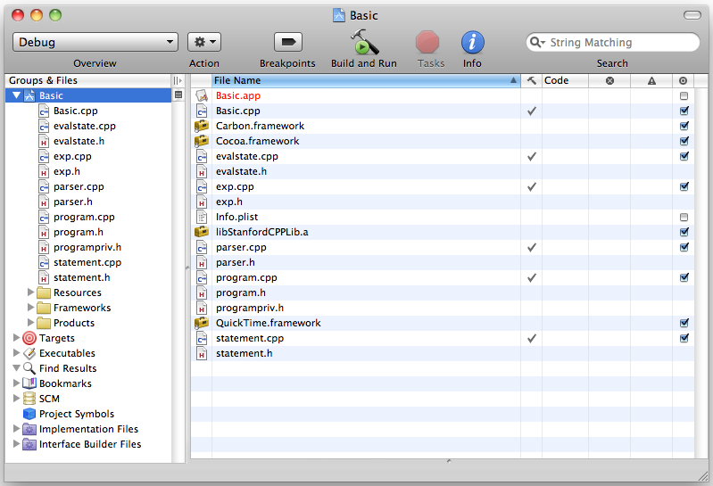
The Basic Starter Project

Slide 54
Modules in the Starter Folder
Basic.cpp
You write this one, but it’s short.
exp.h
exp.cpp
You shouldn’t need to change these.
evalstate.h
evalstate.cpp
You need to make a minor extension.
parser.h
parser.cpp
You need to remove the = operator.
program.h
programpriv.h
program.cpp
You’re given the interface, but need to design both the data structure and the implementation.
statement.h
statement.cpp
You’re given the interface, and need to supply the implementation.

Slide 55
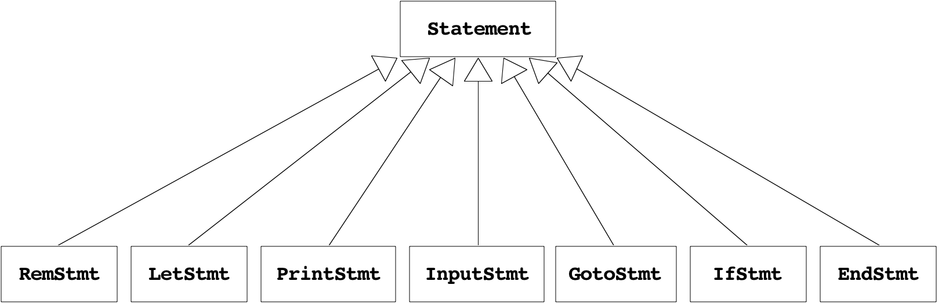
The Statement Class Hierarchy
The students have to construct a hierarchy of statement forms with a parallel structure to the expression class:

Slide 56
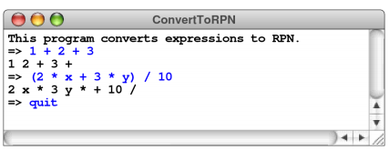
Problem: Convert an expression to Reverse Polish Notation
Write a program that reads expressions from the user in their standard mathematical form and then writes out those same expressions using Reverse Polish Notation, in which the operators follow the operands to which they apply. (Reverse Polish Notation, or RPN, was introduced in the discussion of the calculator in Chapter 5.) Your program should be able to duplicate this sample run:
Your program should work entirely as a client of the exp.h interface.

Slide 57
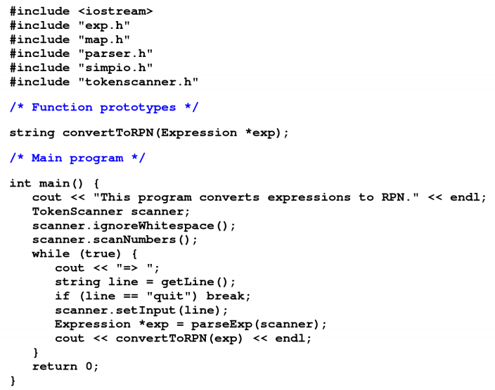

Slide 58
Example
Write a parser for a simplified regular expression
On an alphabet set [a-z], a simplified regular expression is much simpler than the normal regular expression.
It has only two meta characters: '.' and '*'.
'.' -- exact one arbitrary character match.
'*' -- zero or more arbitrary character match.

Slide 59
Reference
PAC Chapter 17 (Eric S. Roberts. Programming Abstractions in C++)
http://en.wikipedia.org/wiki/Chomsky_hierarchy
http://en.wikipedia.org/wiki/Regular_expression

Slide 60
Next
Binary Search Tree /AVL tree

Slide 61
The End

